Slide 1
Evaluation of Style Advisor Performance
Comprehensive Analysis and Insights

Slide 2
Introduction and Objectives
Overview of the Project
Introduction
The project aims to evaluate the performance of Style Advisors using a comprehensive set of criteria. The evaluation data covers various aspects such as store ambiance, first impressions, discovery of customer needs, trial experience, and overall customer service. The primary focus is on understanding how well Style Advisors are performing and identifying areas for improvement.
Scope This analysis includes:
1. Grading the performance of Style Advisors based on their evaluation scores.
2.Creating pivot tables to show average evaluation scores by different zones.
3. Identifying regions with the highest percentage of high performers.
4.Visualizing the results through charts and graphs to provide actionable insights.
5. Preparing a presentation report with detailed findings and recommendations

Slide 3
Objectives
1. Performance Grading: Assigning grades to each Style Advisor based on their Evaluation Score.
2. Pivot Table Analysis: Analyzing average evaluation scores by zone to understand regional performance.
3. High Performer Identification: Determining which region has the highest percentage of high performers.
4. Visualization: Creating visual representations of the data to highlight key trends and insights.
5. Presentation Report: Summarizing the findings and providing recommendations to management.

Slide 4
Data set Columns Explanation
1. Evaluation_ID: Unique identifier for each evaluation record.
2. Evaluation_Date: Date when the evaluation was conducted
3. Evaluation_Score: Score given for the evaluation.
4. STORE AMBIANCE, FIRST IMPRESSIONS, DISCOVERY, etc.: Various criteria used to assess the performance of Style Advisors.
5. Location_City, Location_State, Zone, Location_Country: Geographic details of the evaluation location.
6. Time of entry, Time of exit, Duration of visit (seconds): Timing details of the customer visit.

Slide 5
7. Style Advisors Present, Customers Present: Number of Style Advisors and customers present during the visit. 8. Age of Auditor, Gender of Auditor, Auditor Attire: Demographics and attire of the auditor conducting the evaluation. 9. Style Advisor Name, Style Advisor Description: Details about the Style Advisor being evaluated. 10. Various criteria (e.g., 1.1 - Signage Clean & Well Lit, 2.1 - First Impression): Specific aspects of the evaluation related to store ambiance, customer service, and overall experience.

Slide 6
Performance Grading
Below are the criterias for performance grading
High Performer: 90% - 100%
Average Performer: 70% - 89%
Low Performer: 50% - 69%
Bottom Performer: Below 50%
Example Calculation
For an Evaluation_Score of 58:
Grade: Low Performer

Slide 7
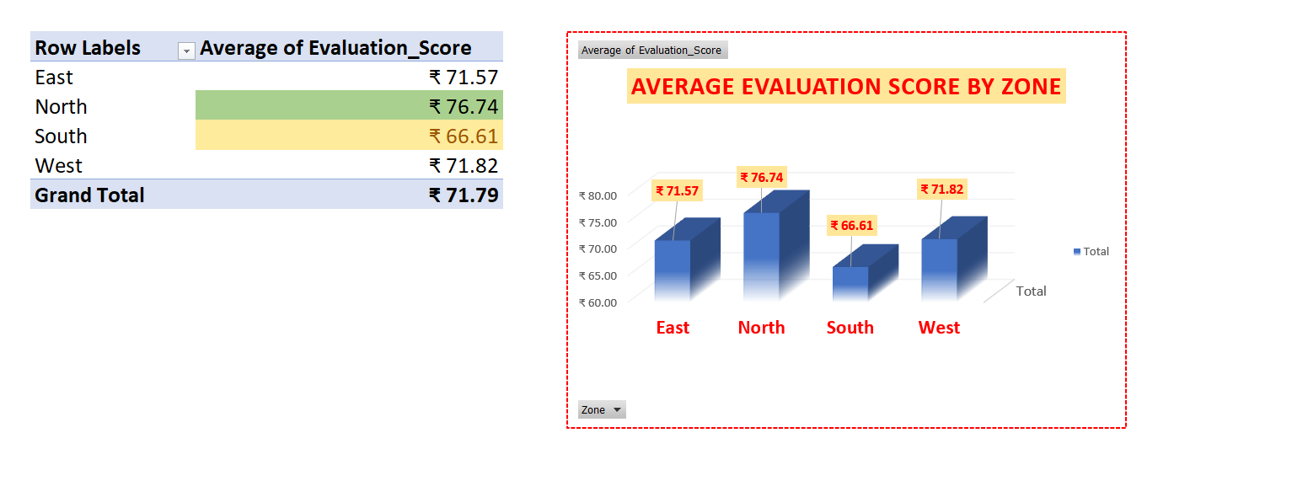
Zonewise Average Evaluation Score
North Zone is showing Highest Average Evaluation Score as compared with other zones.
South Zone is showing Lowest Average Evaluation Score.

Slide 8
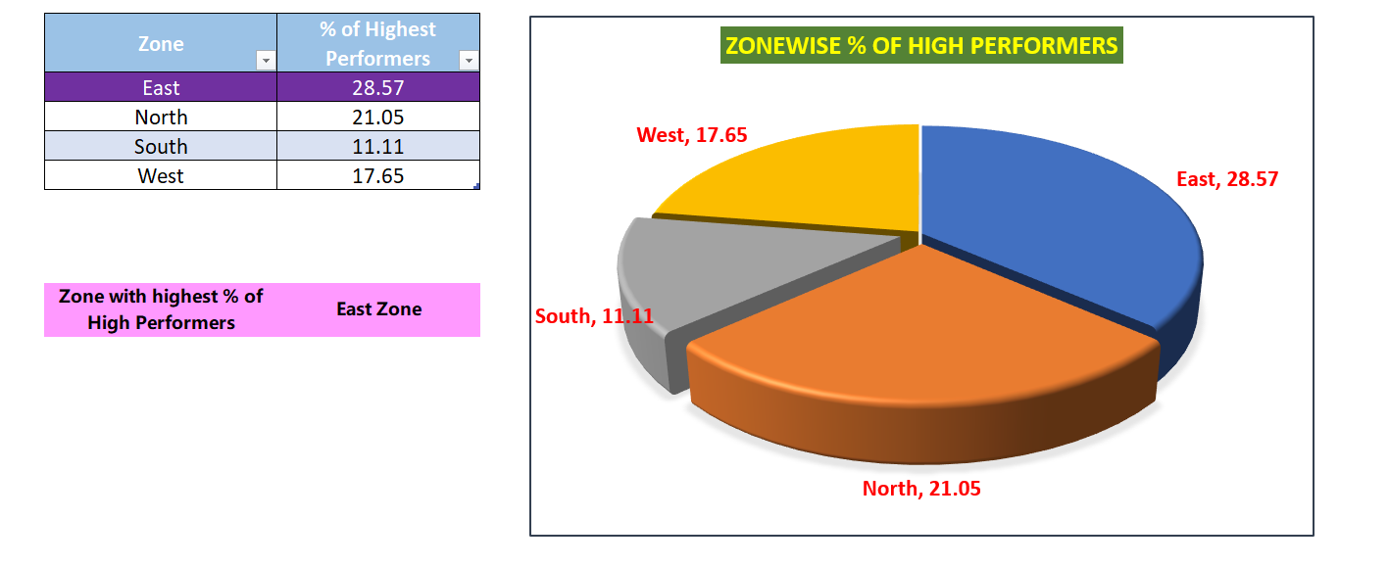
High Performer Analysis

Slide 9
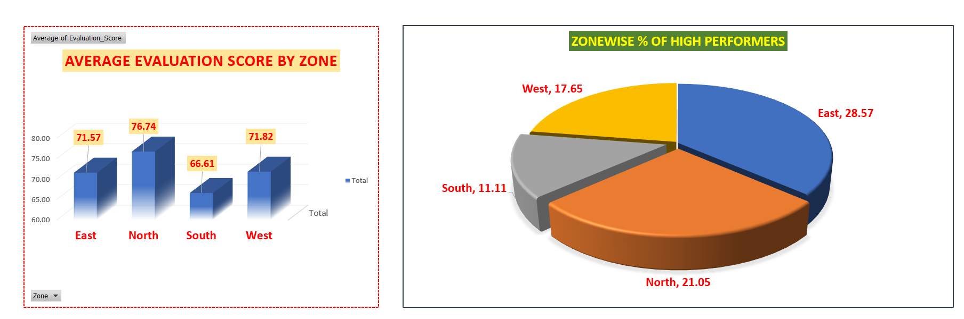
Visualizations

Slide 10
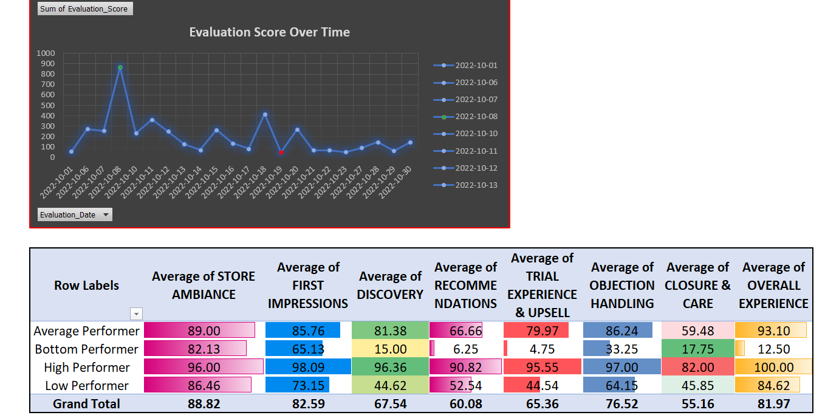

Slide 11
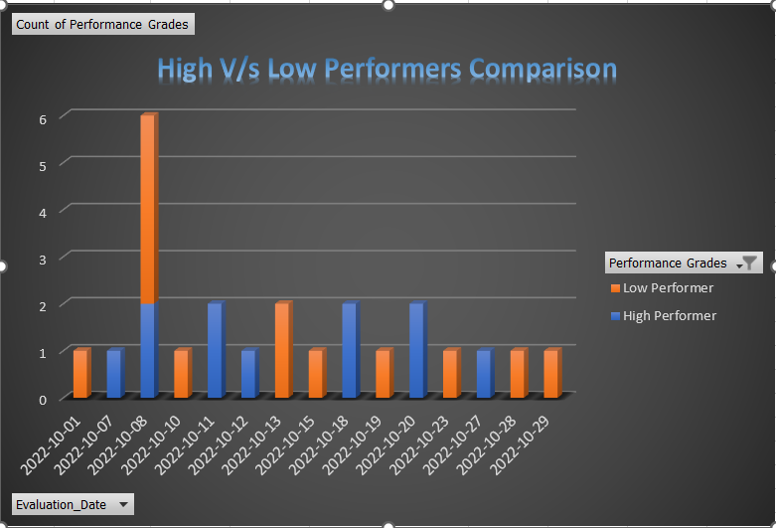
Stacked Bar Chart

Slide 12
Key Insights
Now let’s see what are the key insights from the visualization which we shown in the form of
1.Bar Chart
2.Pie Chart
3.Line Chart
4.Heat Map
5.Stacked Bar Chart

Slide 13
Key Insights
Bar Chart - Zonewise Average Evaluation Score.
In that North Zone is showing highest average of evaluation score i.e 76.74, whereas South Zone is showing the lowest average of evaluation score i.e 66.61.
Pie Chart – Zonewise % of High Performers
East Zone is showing highest % of High Performers i.e 28.57%
Line Chart – Datewise evaluation score.
On 08/10/2024 sum of evaluation score is high i.e 868 and on 19/10/2024 sum of evaluation score is low i.e 52.

Slide 14
Key Insights
Heatmap – It is showing Average Score of performers for Various evaluation criteria.
High Performers evaluation score for various criterias are good. Whereas Bottom performers recommendation is low and overall experience with them is also poor.
Stacked Bar Chart - High V/s Low Performers Comparison.
Comparatively, on 08/10/2024 low performers are 4 and high performers are 2. On rest of the days either high performers or low performers are there. But on 08/10/2024 both are there. Day wise High performers are less than Low Performers.

Slide 15
Recommendations
Bottom Performers need to improve themselves some of them belong to South Zone. As Average Evaluation score of South Zone is also low as per Bar Chart.
Focus Areas for Improvement –
1.Average Evaluation Score of East and West Zone is better as compared to South Zone. South Zone Performers need to make some improvements.

Slide 16
Conclusion
Visualization is providing clear picture of performance trends, high performing zones, etc.
Recommendations to the management would be to focus on overall performance of the style advisors.

Slide 17

We are Open for Questions and Discussions

Slide 18


